Slide 1
Promising EEG-based markers of consciousness
BCI Meeting
Banff 2025
Bjørn Erik Juel

Slide 2
EEG-based marker of consciousness
Measurable signatures in the electrical brain activity that are always apparent when some individual is conscious and is never there when their consciousness is gone.

Slide 3
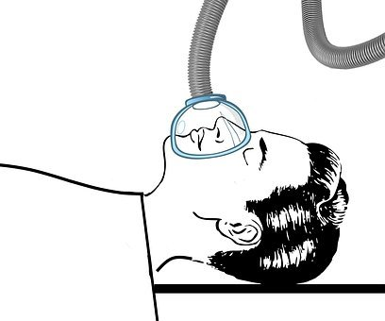
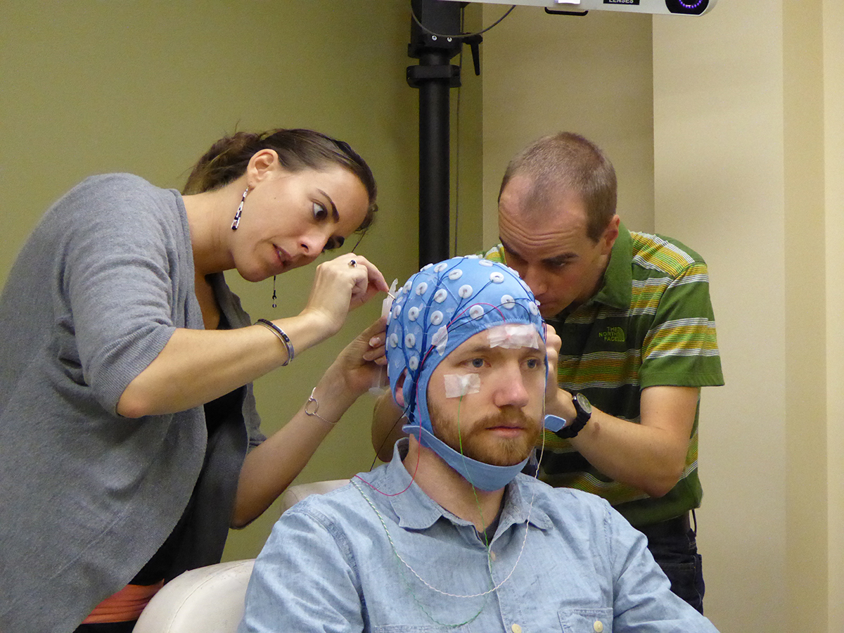
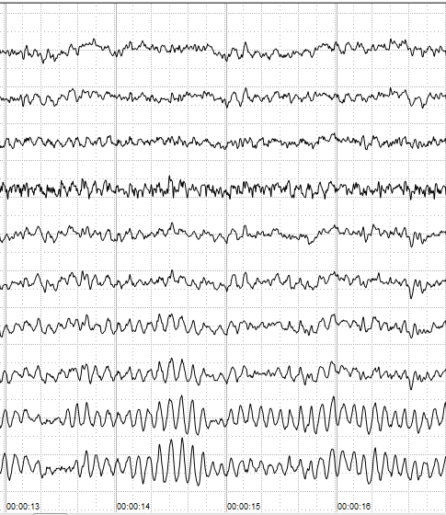
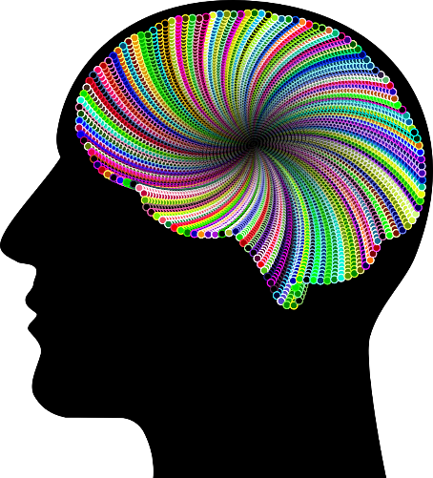

An example strategy for finding an EEG-based markers of consciousness
Measure brain signals from individuals …
... and check if your marker of reliably tracks changes in consciousness!
… in different states …

Slide 4
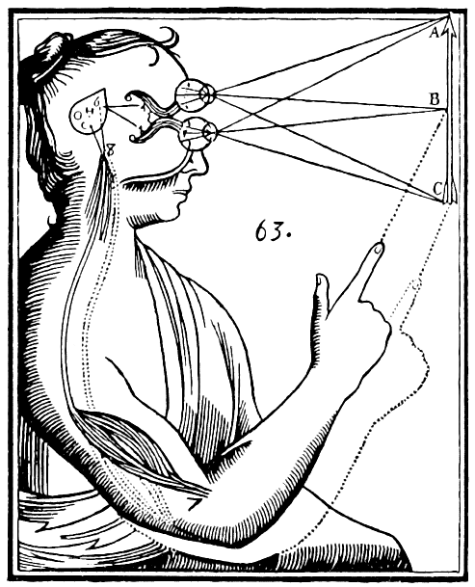
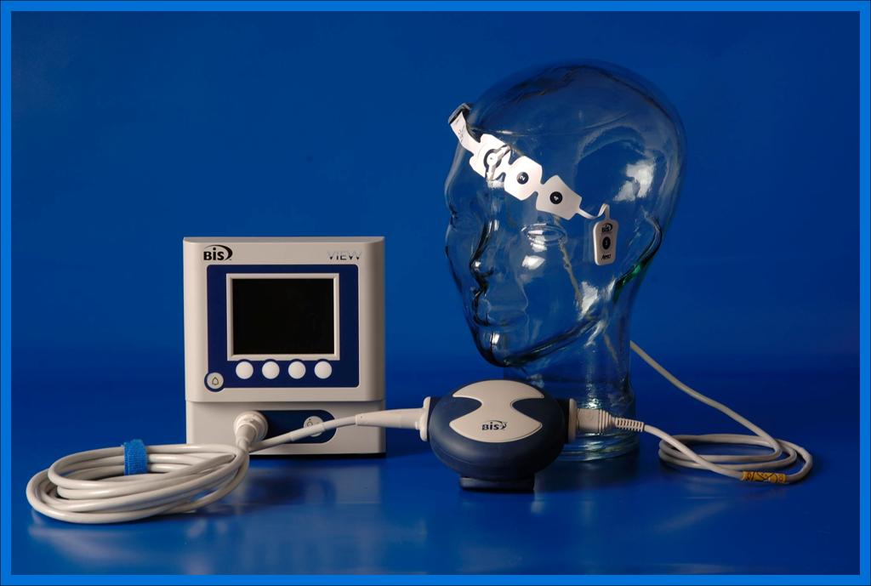
Why do we want markers of consciousness?
Approaching a fundamental understanding of consciousness
Developing tools to aid clinicians in monitoring conciousness in patients
www.wikipedia.com/consciousness
www.covidien.com
Notes:
These are my notes

Slide 5
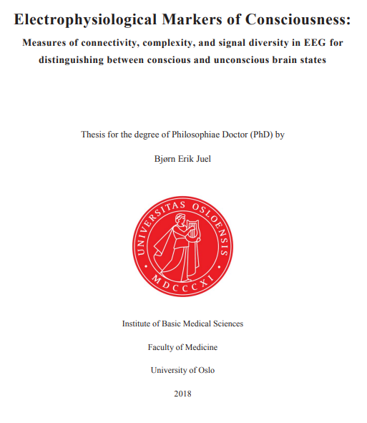

Slide 6
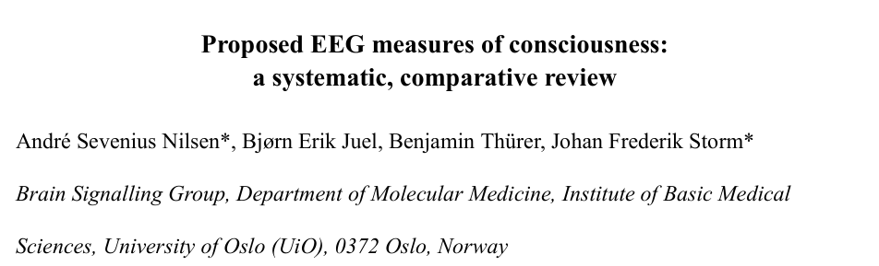
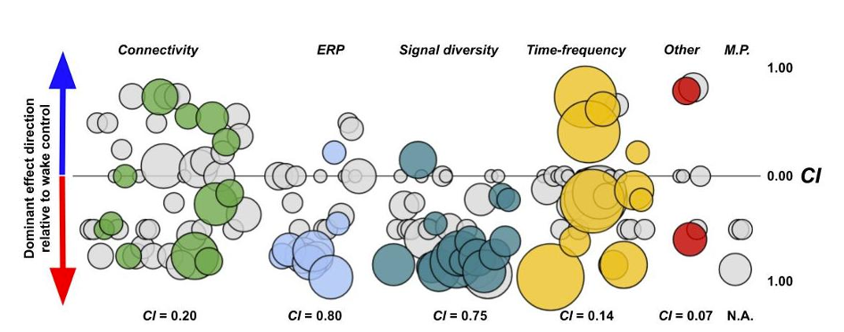
Some examples of Electrophysiological markers of consciousness?
High perturbational complexity index
High symbolic transfer entropy
Strong feedback connectivity
High Lempel-Ziv complexity
Low spectral exponent
High spectral edge frequency
Presence of specific ERP components
High mutual information
High (xyz) entropy
Slow-wave saturation
High fractal exponent
High bispectral index
Small-world connectivity
Low slow-wave activity
Low delta power
Near critical dynamics
Notes:
review of 255 electroencephalography (EEG)-based measures of consciousness in humans.
We show that measures based on signal diversity and event related potentials appear to be the most consistent.
Specifically, spectral entropy, Lempel Ziv complexity, and spectral edge frequency, seem most practical, consistent, and reproducible.

Slide 7

Limitations
Most measures
… are tested without explicit control of conscious experience
… are tested in between state paradigms
… have no clear theoretical grounding
… fail crucial tests (see next presentation).

Slide 8

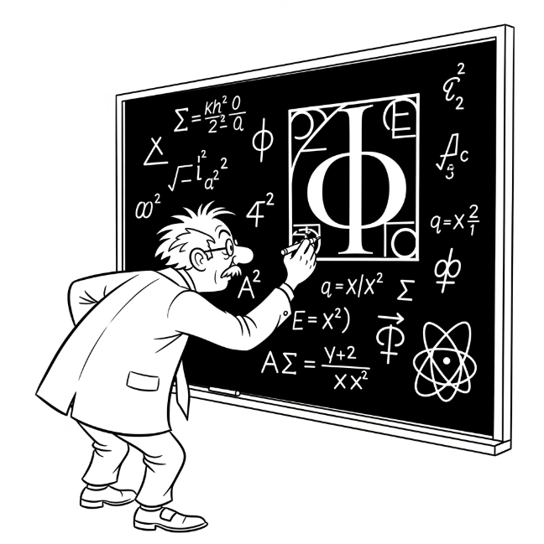
Kinds of EEG markers of consciousness
Theory vs. data driven
State vs. content based
Resting state vs. Evoked activity
http://alltaskstraducoes.com.br/

Slide 9
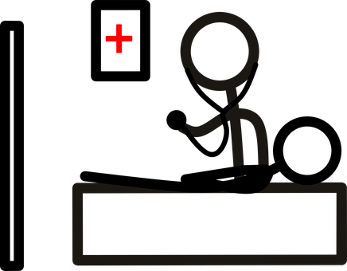
Kinds of EEG markers of consciousness
Theory vs. data driven
State vs. content based
Resting state vs. Evoked activity
Is there anyone in there?
Can they feel this?

Slide 10
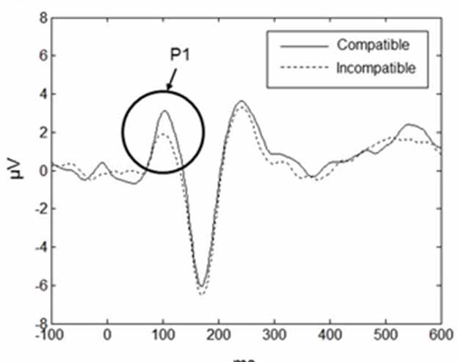
Kinds of EEG markers of consciousness
Theory vs. data driven
State vs. content based
Resting state vs. Evoked activity

Slide 11


One example of a proposed marker: Perturbational complexity index (PCI)
Theory vs. data driven
State vs. content based
Resting state vs. Evoked activity
Massimini
Tononi
Casali et al 2013, Sci Transl Med
Notes:
PCI takes advantage of the theoretical approach
Complexity of the response to simple perturbation – single number
Claim: only high when integrated information is high

Slide 12
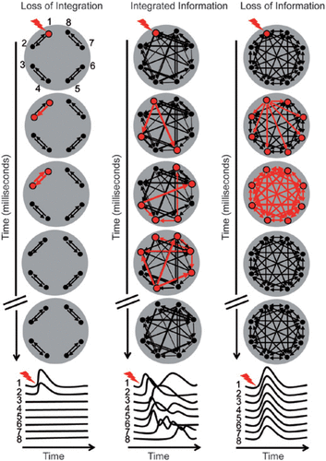
One example of a proposed marker: Perturbational complexity index (PCI)
Low PCI
High PCI
Low PCI
Notes:
PCI takes advantage of the theoretical approach
Complexity of the response to simple perturbation – single number
Claim: only high when integrated information is high

Slide 13
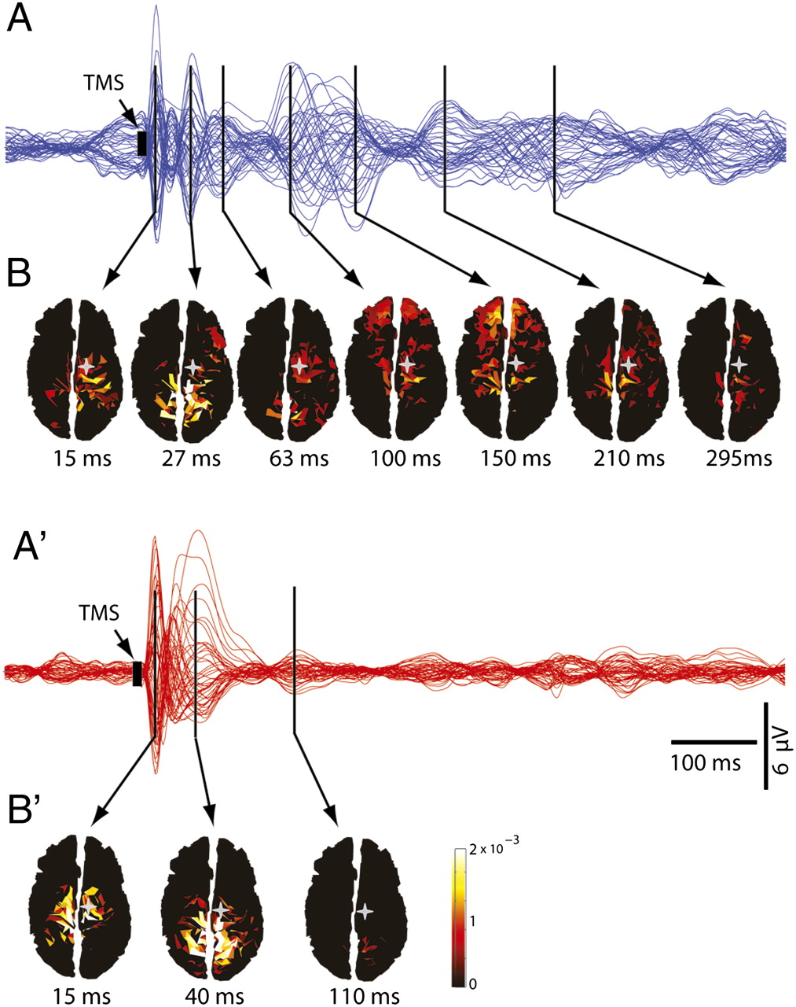
Propofol anesthesia Awake control subject
Ferrarelli et al 2010, PNAS
Notes:
These sorts of measurements in humans
Example from 2010
Stimulated with TMS
Describe figures

Slide 14
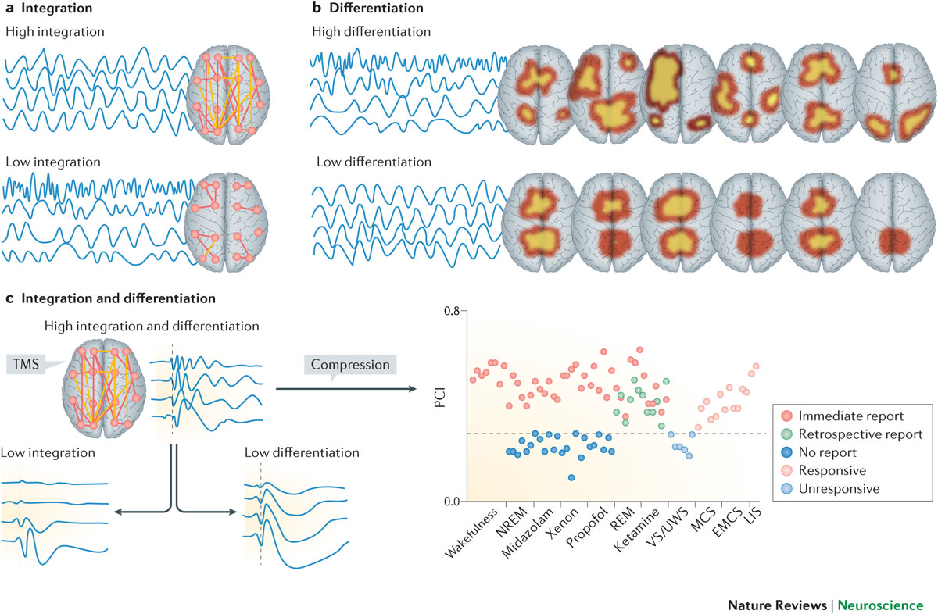
Perturbational complexity index
Awake controls
Vivid dreams
Patients that «woke up» from coma
Anesthesia
Koch et al, 2016
Notes:
Another representation of the same data

Slide 15
So what are promising EEG-based markers of consciousness?
It depends! ☹
An (opinionated) list of characteristics:
Independent of behavioral and physiological state
Theoretically grounded
Practically applicable
Indicative of the structure (content) of the experience

